Slide 1
Estimate State Healthcare Performance Rates Using Minimal Input Variables
MET CS 777
Surya Gopalakrishnan

Slide 2
Introduction – Why Healthcare
Can help policymakers identify underperforming areas.
Right way to put ML and AI to work.
Investigate how well we can estimate state healthcare performance with the data we have.

Slide 3
Public Data Source
My dataset source: https://healthdata.gov/CMS/2024-Child-and-Adult-Health-Care-Quality-Measures-/pahp-sncm/about_data
(Explained the categorical columns in video)

Slide 4
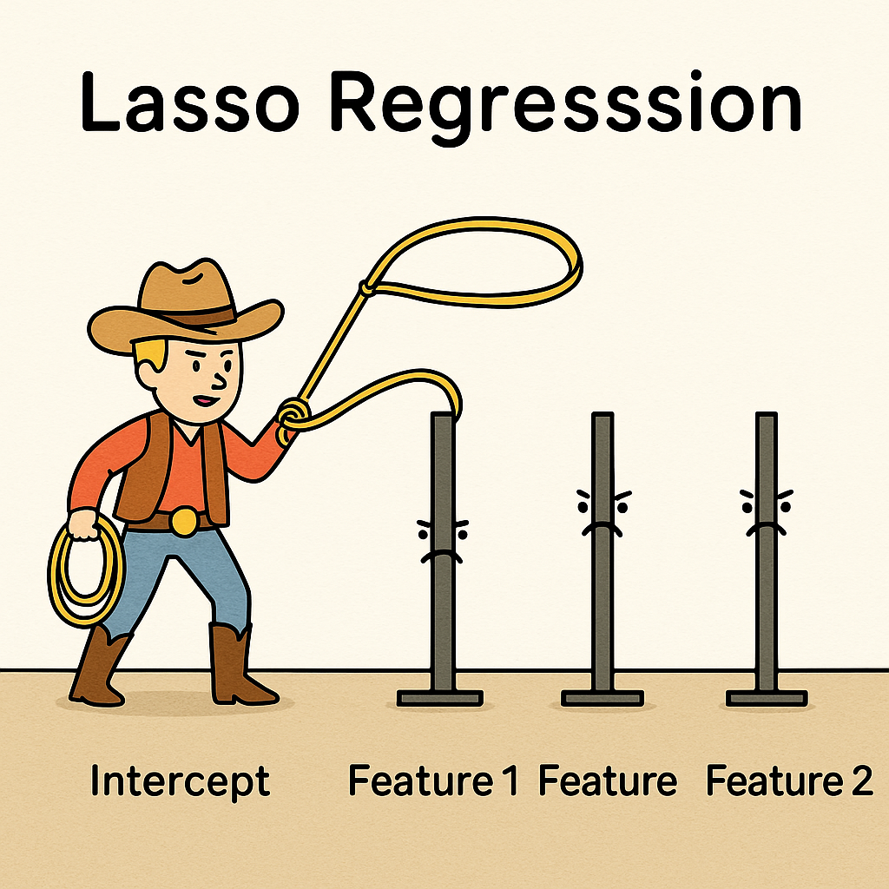
Machine Learning Model
Lasso Regression
Automatic Feature Selection
Valuable for high dimensional datasets

Slide 5

Other Steps in Pipeline
StringIndexer
OneHotEncoder
VectorAssembler

Slide 6

Evaluate the Output
Compare with RandomForestRegressorModel
Why Lasso Model is still solid?

